Slide 1
Review Paper and Data Curation Project
Group 4
Fan Tianyin tfan5@hawk.iit.edu
Li Ziyin zli225@hawk.iit.edu
Liu Yuhai yliu377@hawk.iit.edu

Slide 2
Part II
Data Curation Project

Slide 3
Content
Part 1: Exploring Chicago Public School Data and Surrounding Food Safety
Part 2: Exploring NewYork school location and enrollment

Slide 4
Data Curation Project Part1.
Targets to Solve
1. Data preparation and Cleaning
2. Schema mapping and Dataintegration -- Obtain a long table with the school ID as the primary key (Using Python pandas table/ SQL)
3. Extract data into different types of data tables , such as locations, school types, school_contact_person, school_contact_phone_number, etc.
4. Data warehousing --
School information long table divide to 27tables and create the cs520 Database;
Create the food_inspection Database with 100 tables;
5. Analysis some question :
Calculate the every school less than 5km food risk rate
6. Data persistence -- Store the data into Mysql database:
ETL: Above 27tables information data cleaning ,and create school_info databse and save data to new database.
Load data of the food inspection dataset and cleaning the data divide to 100 tables and insert the cleaning data to the differnt tables .

Slide 5
Information about 4 Dataset use:
Using four dataset(3 datasets about school informations, 1dataset using food inspection datasets, all dataset from City of Chicago Data Portal), the first three Dataset mainly information about school Datasets merge using the primary key School_ID, food_inspection dataset using the Latitude,Longitude these location information.
Dataset Name:
(1) “public schools ” that from Vizier Setup Homework
https://raw.githubusercontent.com/IITDBGroup/cs520/master/vizier/Chicago_Public_Schools_-_Progress_Report_Cards__2011-2012_.csv
(2) “school profile”Chicago_Public_Schools_-_School_Profile_Information_SY2324
https://data.cityofchicago.org/Education/Chicago-Public-Schools-School-Profile-Information-/cu4u-b4d9
(3)”school addmissioin”,Chicago Public Schools - School Admissions Information SY2324
https://data.cityofchicago.org/Education/Chicago-Public-Schools-School-Admissions-Informati/rvbr-fi8c
(4)”Food Inspections”
https://data.cityofchicago.org/Health-Human-Services/Food-Inspections/4ijn-s7e5

Slide 6
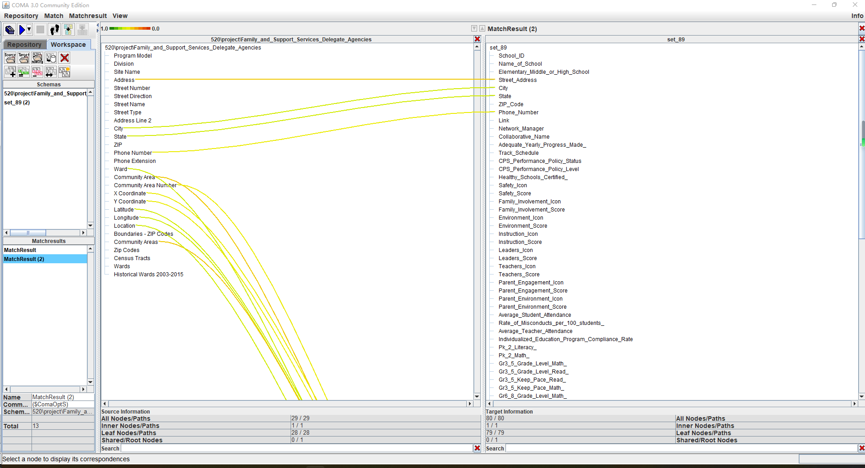
Part1 check the schema matcher tool using COMA:

Slide 7
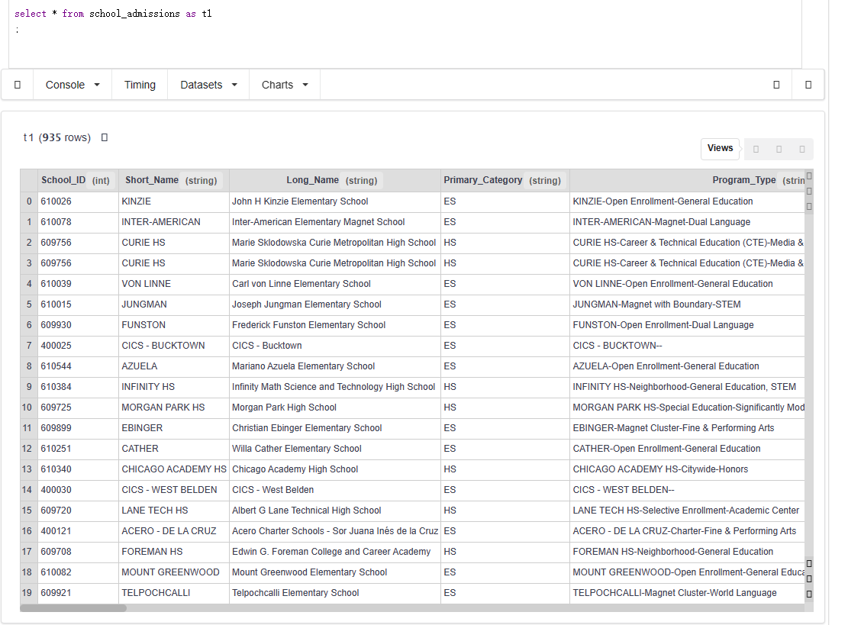
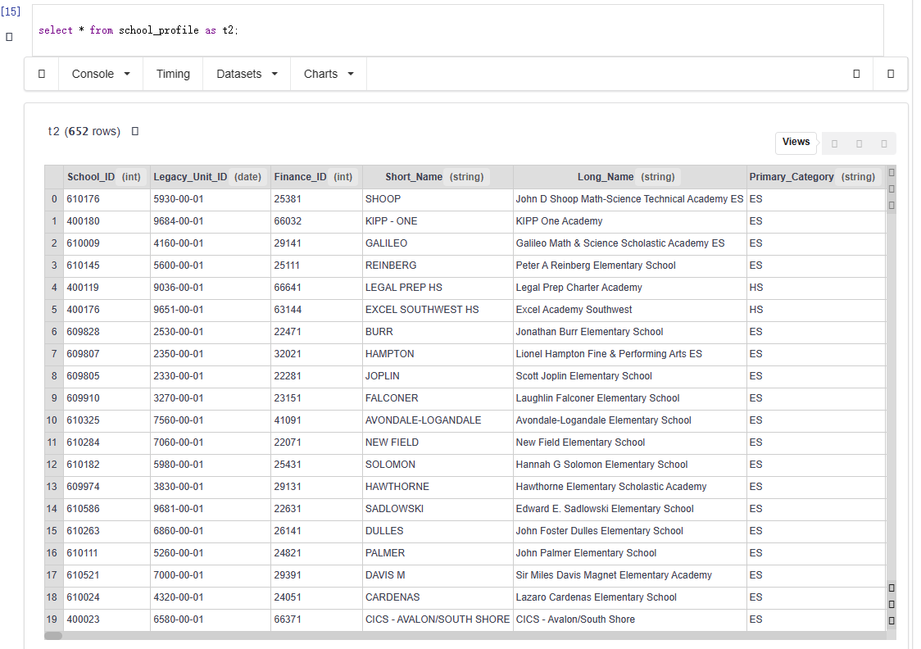
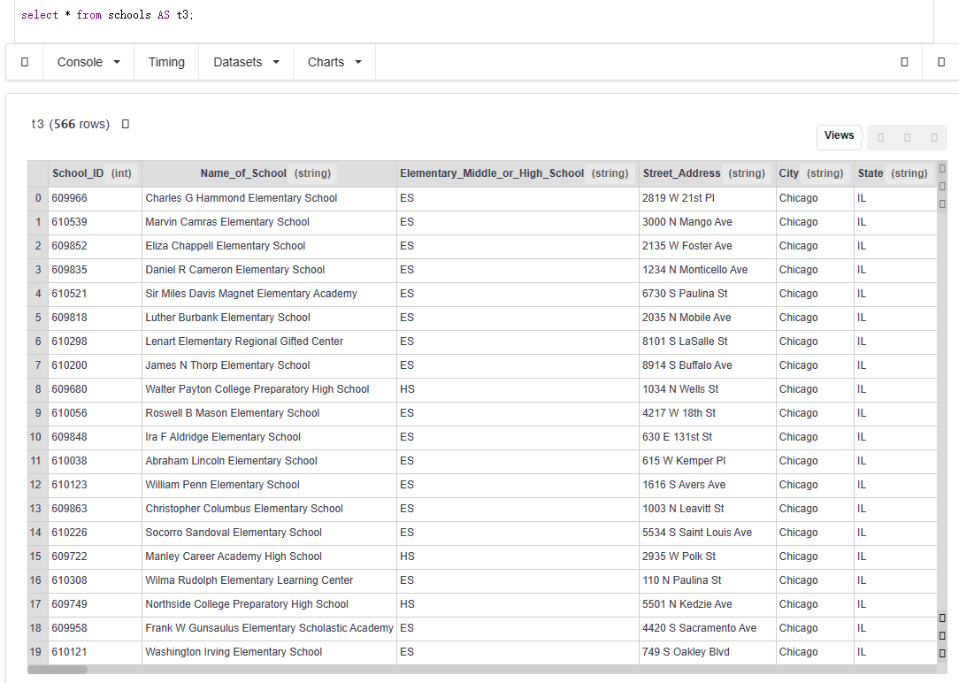
Part1 load school datasets:

Slide 8
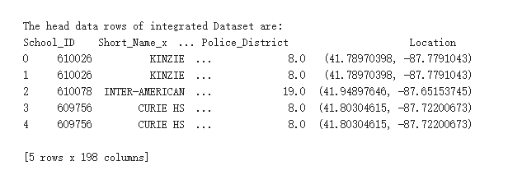
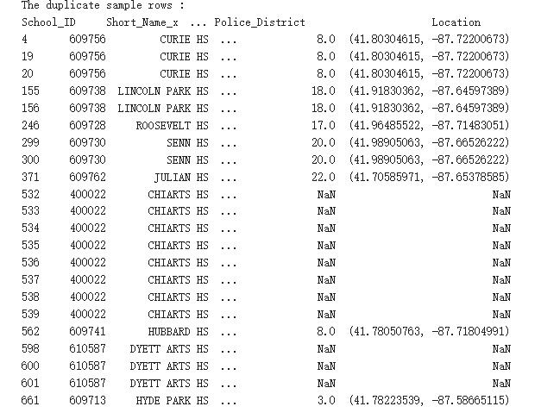
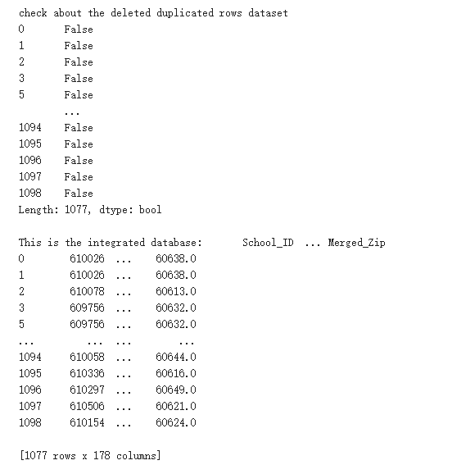
1. obtain school information merged in one long table
2. obtain duplicate rows
3. delete the duplicate
rows

Slide 9
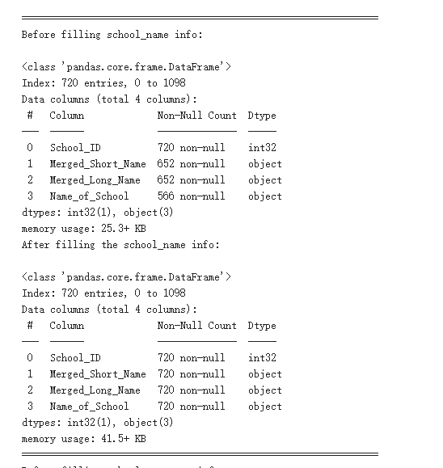
4. cleaning the data and save to different tables

Slide 10
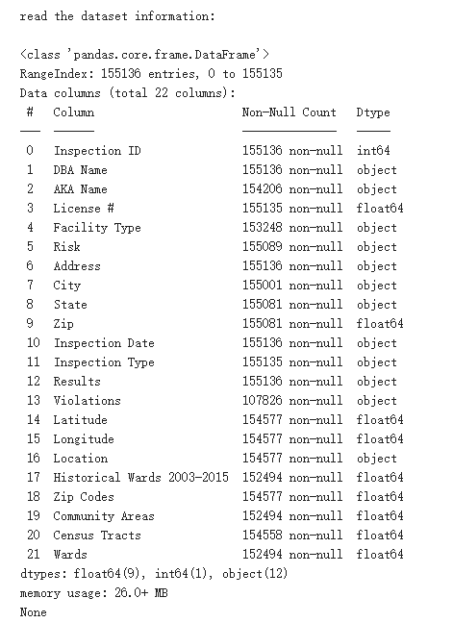
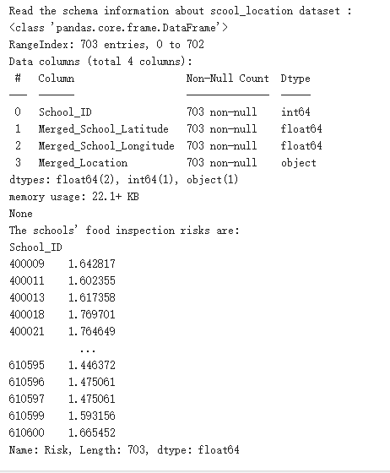
5. load the food_inspections datasets
6. calculate every school <5km food risk value:
Risk 3 (Low),Risk 2 (Medium),Risk 1 (High), so the high:1, medium:2, low:3

Slide 11
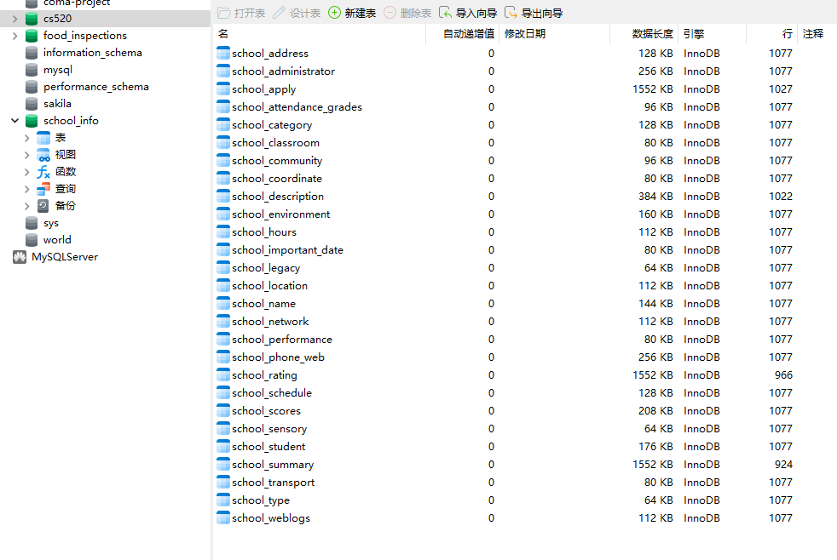
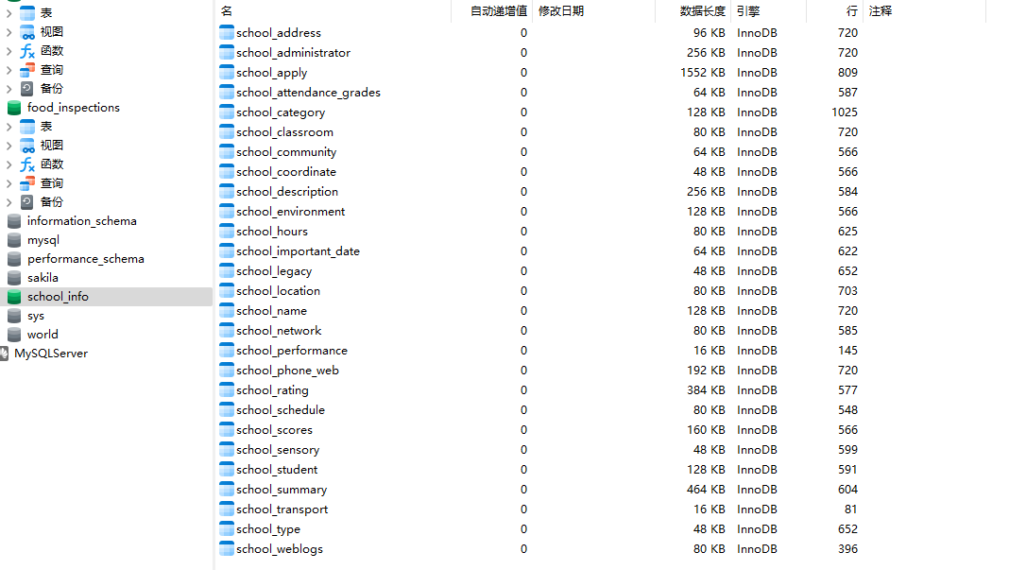
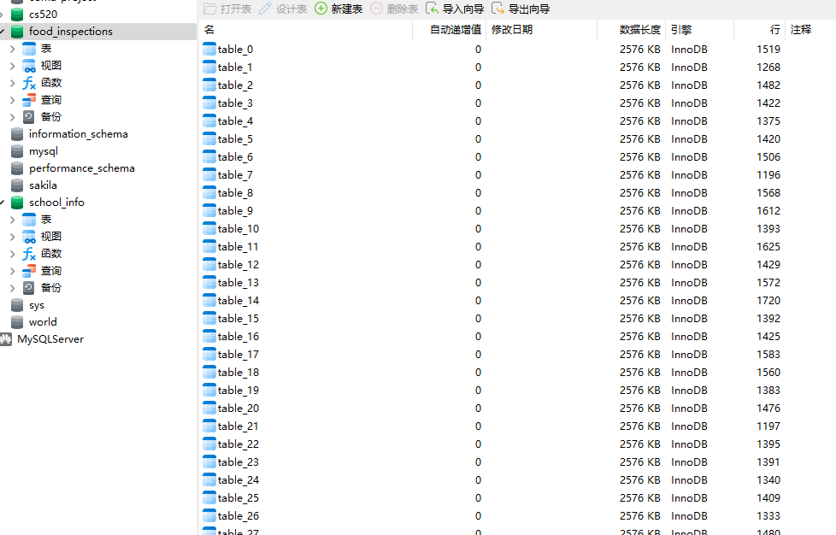
7. Create Database and save the data to different Database:
Database cs520
Database school_info
Database food_inspections

Slide 12
CS Team Project extension
Data Curation Project Part2.
Purpose for this content
Data import
Data analysis
Schema map and merge
Export data
Test result

Slide 13
Purpose
Main task and purpose:
Import different content from different data files into different dataset in order to check out some key information easily and conveniently as below after doing something about data preparation, cleaning, schema mapping, integration.
Extract and Check out some information to schools
school basic info such as, address, name
school’s program, such as, aid, other extra program
enrollment from school, such the status to enroll program
Only use the data that already exist

Slide 14
Data collection
The source of the raw data files: Results for "aid" | Page 1 of 2 | NYC Open Data (cityofnewyork.us)
Files preparation:
File Name | Main Purpose | Public Key
School_Locations | School’s information, such as, school name, address | Location id, Location name
Archived_Application_for_State_Aid | is applying for aid - these dollars are estimated | building id, school name
Current_Plan_Programs | Made the programs plan | School name
Enrollment_Capacity_And_Utilization_Reports_-_Target_by_Building | Enrollment status by build of school | Bldg ID
Enrollment_Capacity_And_Utilization_Reports_-_Target_by_Organization | Enrollment status by organization | Bldg ID

Slide 15
Datasets preparation
Create one project on Vizier
Import all prepared files as datasets
Check each dataset

Slide 16
Data Extraction and Clean
Extract useful data/columns from each dataset.
Removed useless data and duplicated data.
Operate data or records by name and index.

Slide 17
Schema map and merge
Prepare dataset to merge after doing something before.
Public keys generation for two datasets to merge.
Split one or combine more columns to generate the public between two dataset. Because some datasets don’t have the same columns but can do some works to make two datasets have same column.
Specify more columns as condition to merge
Two pairs of columns(4 columns) as the condition to merge different dataset.
Find and utilize differ columns name as public key

Slide 18
Data storge
Test the connection between DB and Vizier.
Create database and table
Export the data in new table

Slide 19
Test result
Reconnect to database.
Checkout the data imported to database.

Slide 20
Thanks for your attention/advices!

